Slide 1
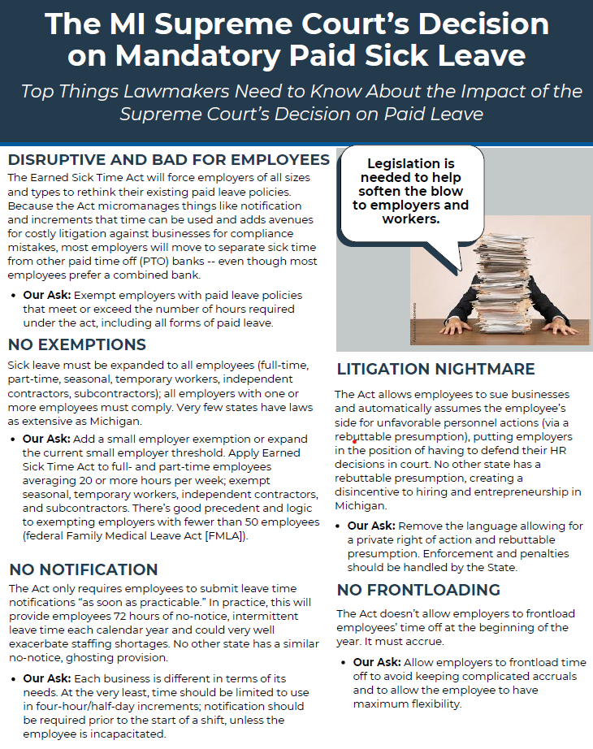
ESTA – Five Key Changes
  Exempt small business and certain classifications of workers.
  Allow employers to frontload time and avoid tracking and carryover requirements.
  Give businesses more flexibility to combine earned sick time with other PTO.
  Avoid a one-size-fits-all approach to advanced notice and increments of time, recognizing that different businesses have different needs.
  Strike private right of action and rebuttable presumption, leaving enforcement with the state.
Notes:
1

Slide 2

Coalition members
Notes:
2

Slide 3
HB 4002
Exempts small businesses (employers with less than 50 employees)
Clarifies the definition of employees eligible for benefits
Retains the accrual method of 1 hour for every 30 hours worked, with usage capped at 72 hours per year, and limiting carryover to 72 hours
Recognizes that employers who frontload 72 hours per year are compliant and do not need to carryover time from one benefit year to the next
Permits employers to provide a single PTO bank that can be used for all purposes including ESTA. Gets rid of “same terms and conditions”
Advanced notice and notification must align with the employer’s customary notice
Employers may limit use of leave to 1-hour increments
Rebuttable presumption and private right of action eliminated
Allows employers to require employees to take ESTA time concurrently with FMLA, or any other applicable law

Slide 4
SB 15
Defines small business as fewer than 25 employees. (Does not exempt. Would mean they could provide 40 hours paid/ 32 unpaid.)
Allows small businesses to frontload 40 hours of paid and 32 hours of unpaid earned sick time at the beginning of the year.
Retains the accrual method of 1 hour for every 30 hours worked but permits frontloading of 72 hours as an alternative to the accrual method, while retaining the carryover from year to year.
Carryover from year to year may be limited to 144 hours if the employer pays the employee the value of the employee’s unused sick time before the end of the year. If the employer does not pay out the value, carryover may be capped at 288 hours.
Employers may limit increment of use to 1 hour.
Rebuttable presumption and private right of action eliminated.

Slide 5

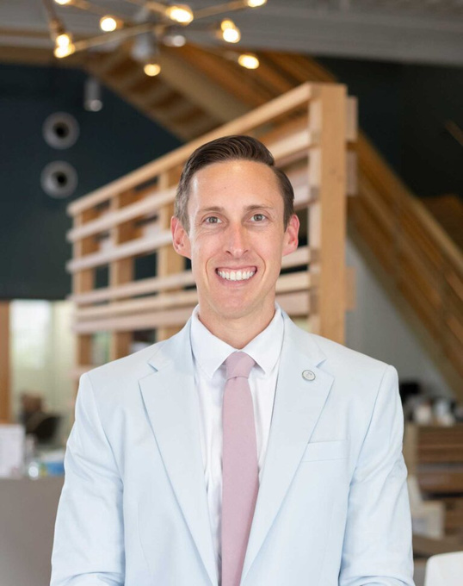


CONTACT INFO:
MARK ALLEN
PRESIDENT
GRAND HAVEN, SPRING LAKE, FERRYSBURG CHAMBER OF COMMERCE
MALLEN@GRANDHAVENCHAMBER.ORG
JOSHUA LUNGER
VP OF GOVERNMENT AFFAIRS
GRAND RAPIDS CHAMBER
JOSH@GRANDRAPIDS.ORG
RACHEL GORMAN
PRESIDENT & CEO
MUSKEGON LAKESHORE CHAMBER
RGORMAN@MUSKEGON.ORG

Slide 6


Slide 7
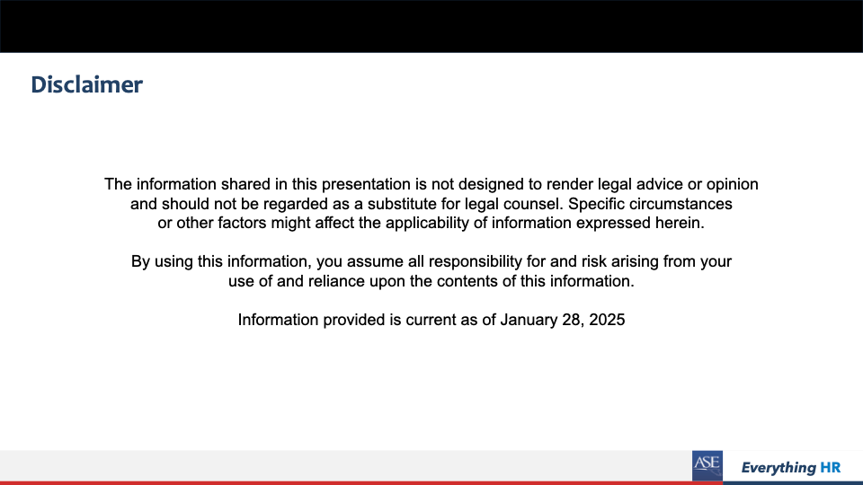

Slide 8
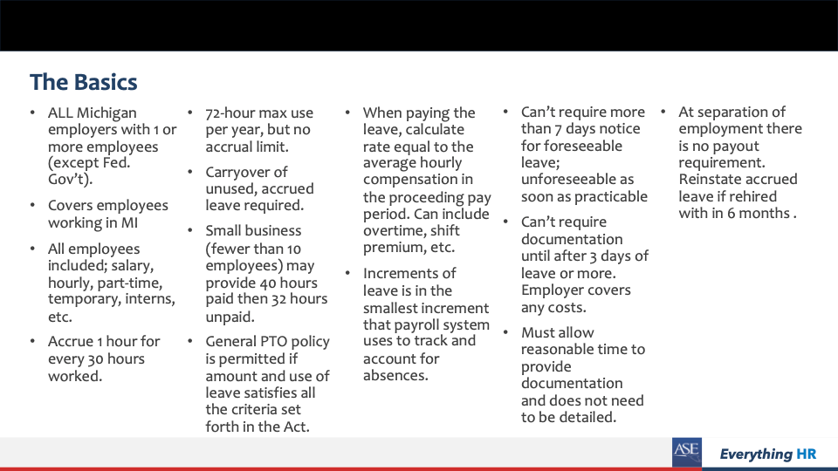

Slide 9
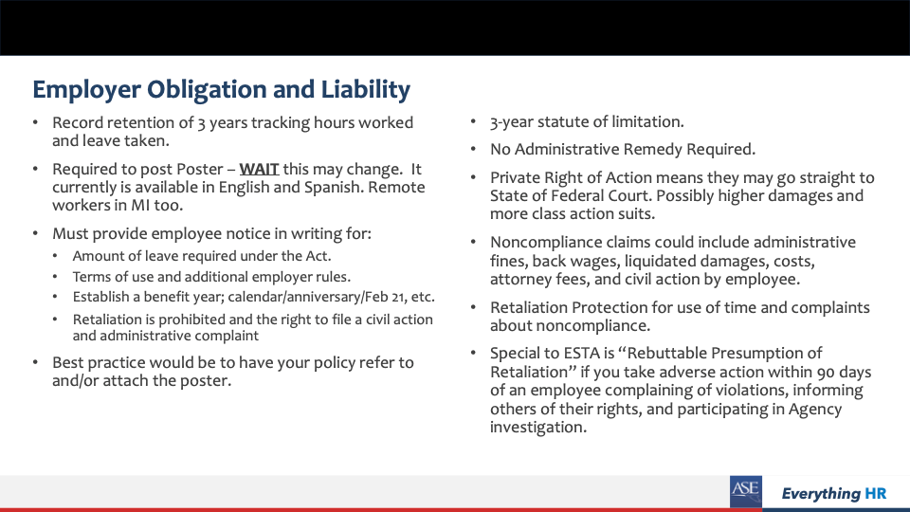

Slide 10
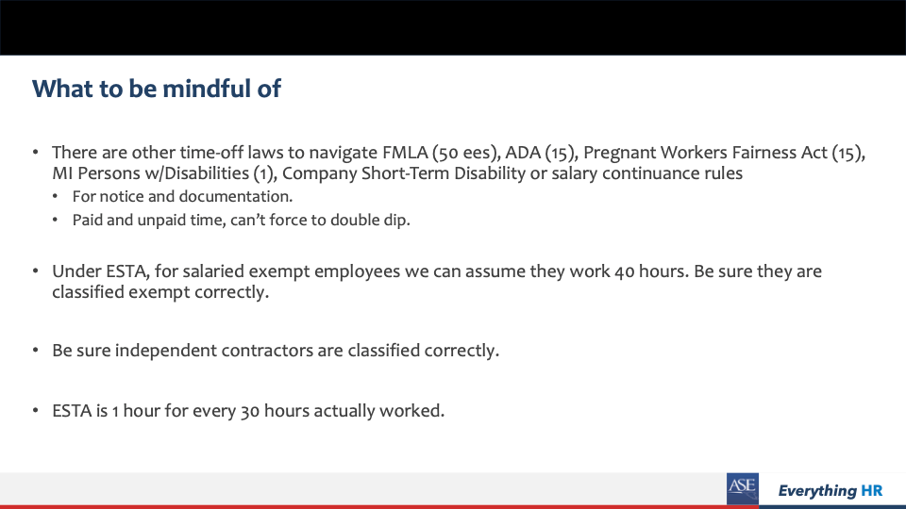

Slide 11
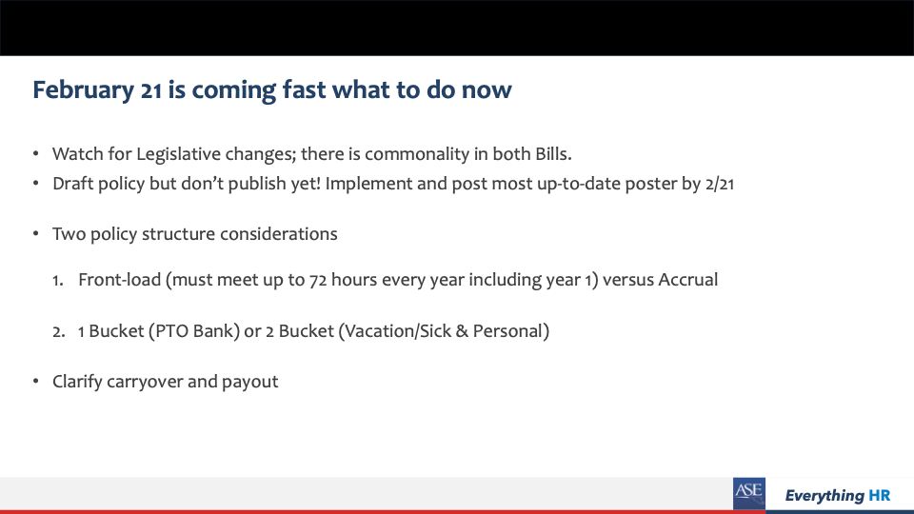

Slide 12
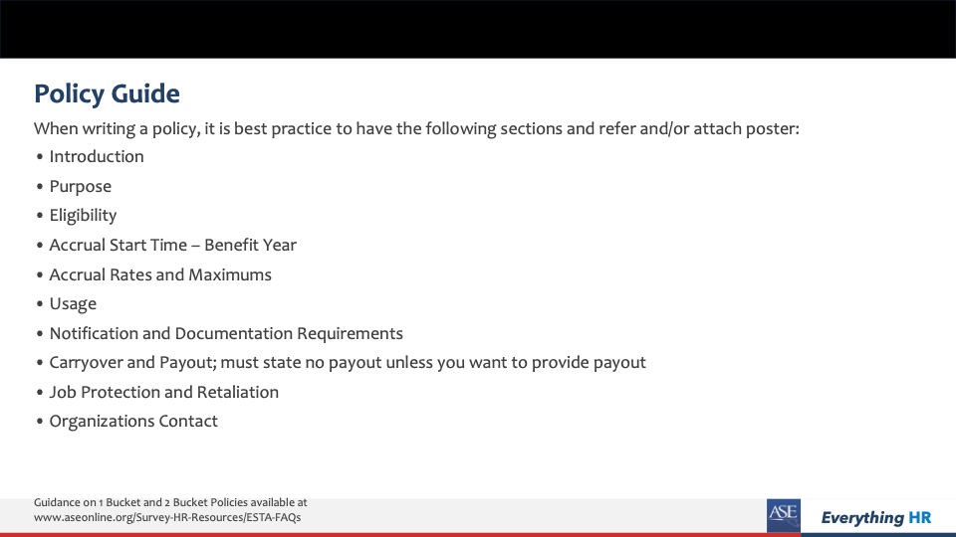

Slide 13
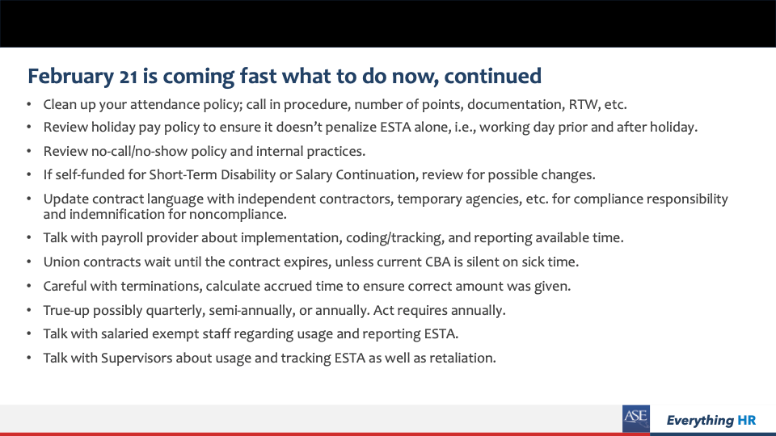

Slide 14
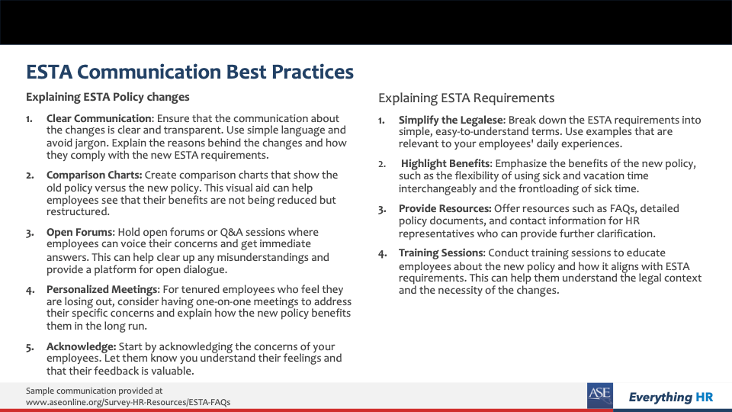

Slide 15


